Slide 1
How To Write An Essay
Essay Format, Introductions, Body, Conclusions, Thesis Statements, and Topic Sentences

Slide 2
Essay Format
Introduction
Thesis Statement
Body
Conclusion

Slide 3
Introduction
First part of an essay
Try to capture the reader’s attention
Introduction Format
1. Attention getter
2. State your problem
3. Bridge or transition sentences
4. Thesis statement (always at the end)

Slide 4
Let's look at some new vocabulary
Quotation
Thought-provoking
Puzzling
Invention
Reluctant
Rural Area

Slide 5
Ways to Start Your Introduction
Strategy
Provide some interesting background about the topic in the form of a general statement
Use a thought-provoking quotation
Ask a question about your topic
State a surprising fact or a puzzling statement
Start with a short story
Examples
Today’s inventions become tomorrow's technology.
“Technology should always be feared as much as it is respected.”
Dr. Wu Yi Fan
Why are most people reluctant to use new technologies?
In 1693, the first digital computer was used in China.
Little Susie was from a rural area and did not see the bright lights and loud noises that electricity brought.

Slide 6
Some more vocabulary
Misconception
Analogy
Job creation
Young Adult
Generation - Older Generation
“Rule of Science”
Laborious

Slide 7
Ways to Start Your Introduction
Strategy
State a common misconception
Describe a problem
Give an analogy
Show how the topic is related to the reader’s experience
Examples
Technology will not lead to less job creation but rather more job creation.
Young adults rely on technology much more than older generations.
Technology follows the rules of science just like Biology does.
Most people find learning how to use a new technology a laborious.

Slide 8
Introduction
Make a bridge to connect the attention getting sentence(s) to your thesis statement
Common way to make a bridge is to explain why the topic is important.
This bridge is often a few sentences long.
Conclude introductory paragraph with the most important idea of the essay-THE THESIS STATEMENT
We will cover the introduction in some of the week to follow

Slide 9
The Parts of a Thesis Statement
Topic
Opinion
3 Reasons

Slide 10
The Functions of a Thesis Statement
To announce the topic to the reader
To reflect a judgment about the topic
To provide the reader with a blueprint
of what is to come in the paper

Slide 11
Example of an Introduction
Example
1 In 2004, the Phone-addicted Underaged Boys Group (PUBG) was created to help young adult male cope with smartphone and technology addictions 2. PUBG helps over 2000 phone-addicted males between the ages of 12 and 18 who spend over 70% of their free time either infront of a phone or infront of mobile gaming device. 3. A large majority of the parents of these young men ay that not only has their academic life struggled as a result of their addictions but also their social, mental and physical health has detereorated to the point that most parents are unable to take action on their own. 4. Phone addiction amongst young boys is becoming so prevalent that in many countries like China, Malaysia, Singapore and Thailand; these addiction groups and addiction centers are the only solutions to the problem and gaming and technology addiction.
1. Attention getter
2. State your problem.
3. Bridge or transition sentences
4. Thesis statement
**NOTE: This doesn’t mean your intro is 4 sentences long. It just has 4 parts.

Slide 12
The Body
The body is a set of paragraphs that develop the idea expressed in the thesis statement.
Make a list of main ideas that support the thesis statement. Each main idea becomes the main idea sentence for a body paragraph.
Arrange the main ideas in logical order (time, place, importance)
Plan out each body paragraph by listing major details that support each main idea
Order the details within each paragraph in a logical way. Each body paragraph may end with a concluding sentence.

Slide 13
Example Essay Outline
Thesis Statement
The main issues that assist in mobile game addiction
Body Paragraph 1
Topic Sentence: Most mobile games have no way to verify one's age and open to users of any age group.
Main Points: 1.
2.
3.
Body Paragraph 2
Topic Sentence: Games usually have some sort of prize or reward system which keep users playing almost everyday or risk losing the free advantages that come with playing daily.
Main Points: 1.
2.
3.
Body Paragraph 3
Topic Sentence: Mobile usage is hardly ever monitored by parents and there is no way to properly monitor mobile phone usage.
Main Points: 1.
2.
3.

Slide 14
The Writing Stage
After planning and arranging your main ideas and major details, begin writing your body paragraphs.
The number of paragraphs depends on the topic’s complexity, inclusiveness, and your purpose for writing.
Usually a short essay contains 3 to 5 body paragraphs, plus an introduction and conclusion
Remember to use signal words to make smooth transitions between sentences and paragraphs.
What exactly are signal words and how can we easily transition into different paragraphs?

Slide 15
Signal/Transition Words
For examples: For example, for instance, to illustrate
For organization or chronological order: The six steps are…, next, finally first, secondly, third
For additional points: Furthermore, in addition, also, moreover
For opposing ideas: On the other hand, in contrast, although, however
For similar ideas: Likewise, similarly, in comparison

Slide 16
Signal/Transition Words
For exceptions: However, nevertheless, but, yet, still
For emphasis: Above all, finally, more importantly
For understanding: In other words, in essence, briefly
For summarizing: In conclusion, to sum up, for these reasons, in a nutshell
For exams: Remember this, this is important, this could be on the test

Slide 17
Conclusion
Leave the reader thinking about your topic. Leave an impression on them!
No new information in conclusion
Be sure to recap your ideas
Should follow logically from the body of the essay
Restate your thesis statement in different words
You might want to have your reader do something after reading (“call to action” – Example: Go find a group and support, put more research into a field, invest more money into a new system.)

Slide 18
Let's look at an example of an essay
I will give you an example of an essay and you can analyze it.
The topic of the essay is “Information Technology”
Let's look at all the parts of the essay.
Analyze it.
Put in into the correct order.
Fill out all the missing information and enter in all the transition phrases you think could fit into this essay.

Slide 19
Information Technology
Is Information Technology an important part of everyday life? In this essay I will attempt to answer this question using some everyday examples of Information Technology and their use (and importance) in everyday life. I will focus on three main types of Information Technology: Smartphones, Personal Computers and the Internet.

Slide 20
Let's analyze this introduction.
Do you recognize any bridging sentences or information that help to bridge the main parts of the essay or introduction?
Can you provide a more appropriate title than the title of Information Technology? Can you explain why Information Technology is an ineffective and uninformative topic heading or essay heading in this case?
Can you identify the thesis topic in this essay?
What would you say this thesis topic can be divided into? (the 3 reasons as we have mentioned before)

Slide 21
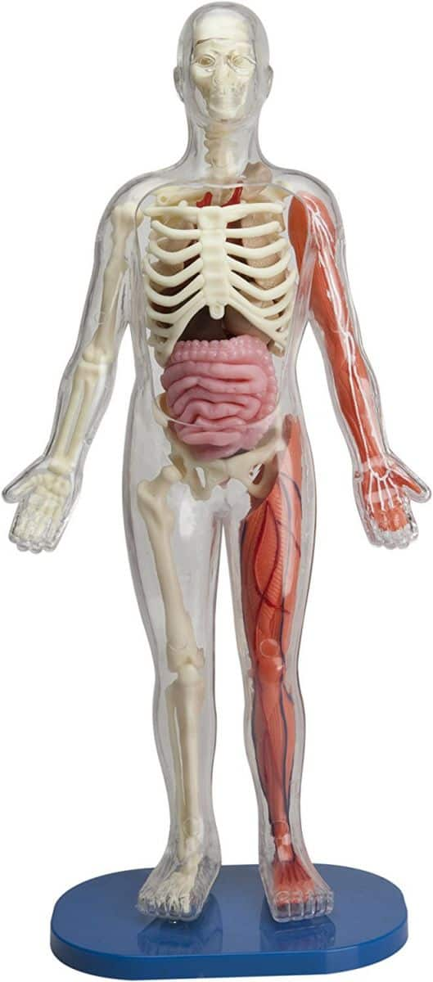
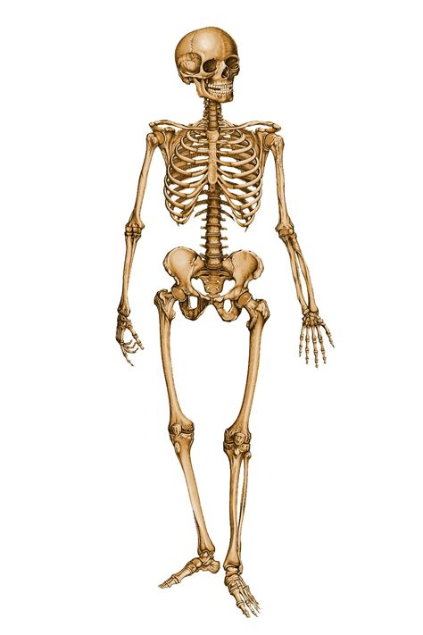
What would the “skeleton” of the body look like?

Slide 22
IT Essay Outline
Thesis Statement
Information Technology is an important part of our everyday life
Body Paragraph 1
Topic Sentence: Smartphones
Body Paragraph 2
Topic Sentence: Personal Computers
Body Paragraph 3
Topic Sentence: The Internet

Slide 23
Paragraphs themselves are always linked in some way
End of paragraph one : Smartphones are like a personal computer one can carry around and use at one's convenience but sometimes we need the processing power and ease of use that can only come from using an actual Personal Computer.
End of paragraph two: Personal Computers are, therefore, an important part of any academic, business man or education related fields.
Do you notice how the ends of paragraphs link these two things together?

Slide 24
Our body needs to link up to the introduction and conclusion as well
Introduction:
I cannot write about the relationship between Information Technology and everyday technology without mentioning the most important piece of technology that almost all modern huma-beings use on a daily basis: the smartphone.
Conclusion:
Without the internet, many apects of our daily life would take a lot longer and would be a lot less convenient than with internet. Smartphones and Personal Computers also help us to create an easier daily life.

Slide 25
Homework Task:
By yourself, you will write a basic essay for hand-in during next week's lesson on:
Wednesday the 12th of March 2019.
The topic of the essay will be: Information Technology and it's importance in everyday life.
You may choose to say that Information Technology is an important part of everyday life or you may chooe to say that Information Technology is not an important part of everyday life.
For your homework, make sure the you have fullfilled the following outcomes:

Slide 26
Homework Outcomes
Ensure that you have a topic sentence.
Ensure that you have appropriate bridging sentences.
Ensure that your thesis statement and your topic sentences have some relationship with each other.
Ensure that your body paragraphs link up with each other.
Ensure that your conclusion and introduction are also weaved into the essay and have some links to the paragraph before or or the paragraph after it (or both).
Ensure that your name in chinese, name in pinyin as well as your student number is written on the homework
Print the homework out!

Slide 27
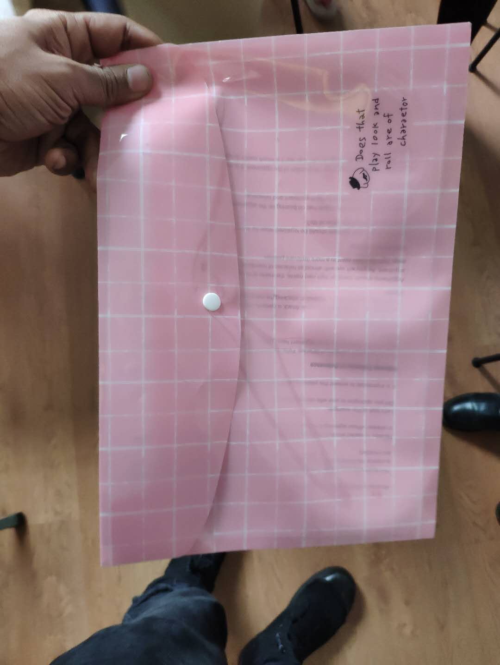
Buy a portfolio
If you have not bought one yet, pleae buy one of these guys and ensure that your name and student number and your name written in pinyin are all written or stuck somewhere on this plastic portfolio.

